Slide 1
Understanding Sexual Assault Trauma: Improving our response to Title IX Violations
John D. Foubert, Ph.D.
Dean and professor, college of education
Union university
John.Foubert@gmail.com
www.johnfoubert.com

Slide 2
Disclaimer
This can be difficult
Take care of yourself

Slide 3
Ever Forced to have Sex (rape): High School
Girls 14%
Boys 4%
Center for Disease Control & Prevention, Youth Risk Behavior Survey, 2021

Slide 4
Sexual Violence During Previous Year: High School
Girls 18%
Boys 5%
Centers for Disease Control and Prevention. Youth Risk Behavior Survey 2021

Slide 5
Rate of Rape and Sexual Assault Since Enrolling at Christian vs. Secular Colleges
Christian Secular
Rape: 4% 10%
Sexual Assault: 15% 24%
Best, N.A. (2017). Campus climate matters: Predictors of the prevalence of sexual violence victimization. Doctoral Dissertation

Slide 6
Rate of Sexual assault for women and men at Christian and secular institutions
Christian Secular
Men 5% 21%
Women 25% 40%
Foubert, J.D., Durham, A., Houston, M., Vanderwoerd, J. (2021). Sexual violence at Christian and Secular Universities: Does institutional type matter? Christian Higher Education, 20(4), 257-270. DOI: 10.1080/15363759.2020.1806143

Slide 7
Rate of perpetrating sexual assault for women and men at Christian and secular Institutions
Christian Secular
Men 5% 10%
Women 1% 3%
Foubert, Durham, Houston & Vanderword, 2021

Slide 8
Bystander Intervention: Willingness to Intervene
Men at Christian Colleges are more willing to intervene than men attending secular universities (medium to high effect size).
Women at Christian Colleges are more willing to intervene than women attending secular universities (low to medium effect size).
Foubert, Durham, Houston & Vanderword, 2021

Slide 9
Bystander Intervention: Confidence
Men at Christian Colleges are more confident they know how to intervene than men at secular institutions (low effect size).
Women at Christian Colleges are just as confident as women at secular institutions that they know how to intervene.
Foubert, Durham, Houston & Vanderword, 2021

Slide 10
Bystander intervention: Barriers to intervening
Men at Christian Colleges have the same amount of barriers to intervene as a bystander as men at secular institutions.
Women at Christian Colleges have fewer barriers to intervene as a bystander than women at secular institutions.
Foubert, Durham, Houston & Vanderword, 2021

Slide 11
During A traumatic Situation: Adrenals Release 4 Hormones!
Adrenaline fight
Catecholamines flight
Opiates physical pain
Oxytocin emotional pain

Slide 12
Opiates: Big Increase!
Good: physical and emotional pain.
Bad: flat affect.
Worse: Makes survivors seem aloof and uncaring
Terrible: People question veracity of survivor

Slide 13
CatEcholAmines: Very High
Good: Help for fight or flight
Bad: Harm memory!
(Memory is accurate but fragmented).
Worse: Get in the way of rational thought!
If you can’t think rationally, you don’t act rationally.
Roozendale et al, 2009; Rubin et al., 2008; Cambpell, 2013

Slide 14
Meanwhile in the Memory Center…
Hippocampus: Turns information into memories. Organizes information and stores it.
Normal State:
Trauma State:

Slide 15
How do we act in traumatic situation?
Pre-frontal cortex shuts down
Habits – includes speech patterns
Habitual behavior in sexual situation is typically nonverbal rather than verbal so “no, stop” is often not a response
Kozlowska, K., Walker, P., McLean, L., & Carrive, P. (2015) Fear and the defense cascade: Clinical implications and management. Harvard Review of Psychiatry, 23 (4), 263-287.

Slide 16
In Trauma
Prefrontal cortex impaired
High stress plus threat, danger, or fear = you can’t ‘calm down and think clearly’
Lose ability to control attention.
Lose ability to encode memories into stories with a beginning, middle, and ending.

Slide 17
Hormones: The Help and The Harm
Help: Huge release of hormones help the emotional and physical safety of survivor.
Harm: Hormone release also makes it very hard for the brain to save and remember information!

Slide 18
Fight or Flight?
Summary: Threat, Freeze, then Fight, Flight, or another Freeze.
Not really Just Fight or Flight
Begins with a freeze that prepares us to move (unlike other freeze responses)
Avoid detection by predators
Assess and respond to threats
Process is unconscious

Slide 19
Corticosteroids Decrease
The body is working on blocking pain, so it has less energy, massive decrease in corticosteroids.
Many victims freeze!
Flood of 4 hormones lead to either:
Fight
Flight
Freeze – 3 kinds

Slide 20
Sexual Assault and Trauma
Victims don’t choose responses, they are automatic.
3 most likely survival reflexes
Dissociation
Tonic Immobility
Collapsed immobility

Slide 21
1. Dissociation
Brain disconnects from our awareness of what is happening to the body.
Person looks ’spaced out’

Slide 22
2. Tonic Immobility
Person is likely alert and aware
Unable to move, talk, or cry out while still aware of what is happening to their body.
Creates ‘waxy mobility’ in limbs
May stare, be cold, numb, insensitive to pain.
50%!

Slide 23
3. Collapsed Immobility
Freeze like an opossum. A reflex.
Has a sudden onset, gradual offset
Can’t speak or move, loses muscle tone.
Faints or passes out.

Slide 24
Perpetrator Behavior & Victim Brains
Perpetrator plays nice, works to be detected as not a threat.
Activates attachment circuitry in brain.
Suppresses the defense circuitry
Perpetrator pushes boundaries
Conflict in brain between defense and attachment circuitries. Takes time to resolve.
Victim then gets gut level, intense fear response “This is really happening to me”

Slide 25
Brains of Perpetrator and Victim
Perpetrator
Victim
Not stressed
Prefrontal cortex in control
Thinking and behavior is:
Planned
Practiced
Habitual
Afraid, overwhelmed
Fear circuitry in control
Attention and thoughts driven by perpetrator actions
Behavior controlled by habits and reflexes

Slide 26
So What Does This Look Like in a Real Case?
House party
20 year old woman
Met a guy
“no, no, no, I don’t want to do this. I don’t know you.”
(Campbell, 2013)

Slide 27
The rape begins
Pins her down
She realizes…
Tonic immobility
Completely frozen throughout.

Slide 28
And becomes a gang rape
“I just had sex with Jane Doe and she is still in there.”
Men lined up…

Slide 29
The bystander intervenes
One of her friends overhears the guys
Friend barges in
“I felt like I was lifting a dead body. I was like shaking her, trying to get her to like snap out of it. I had to sort of physically drag her out of there.”

Slide 30
Hospital
Friend takes her to the hospital
Exam done, a police report is filed.
Police would not pick up the kit.
Because she was sexually assaulted by multiple men at the party, they said the kit would be “a sloppy mess” and it would be too difficult to figure out whose DNA was in there.

Slide 31
Case Closed
Police closed the case.
“Well, she just laid there, so she must have wanted it. No one wants to have a train pulled on them, so if she just laid there and took it, she must have wanted it.”
He doesn’t know of an alternate explanation.
The other explanation is tonic immobility.
An opportunity for change!

Slide 32
QuestionS:
Based on what you have heard so far, what are some ways you’d expect a rape survivor to act when there is an investigation going on?
What are some things the survivor could say about the sexual assault that, to an untrained person, could lead one to believe she was lying?
Given what you have learned so far, what are you going to make sure you remember about how the brain and body react to trauma when you are talking with a survivor?

Slide 33
PTSD & Survivor Testimony
What Does A Changing Story Mean?

Slide 34
What Survivor Goes Through Afterward: PTSD
1. Acute Disorganization/Emergency (up to 3 months)
2. Denial (around 3 months in)
3. Repetitive/Reorganization (at about 9 months)
4. Integration/Recovery (1-2 years later)

Slide 35
Instructions
You will be assigned a stage of PTSD based on where you are sitting.
Pretend you are investigating this case.
Assume the survivor is in the stage of PTSD/Rape Trauma Syndrome assigned to you.
In groups of 2-3 people, together write one or two sentences, in the survivor’s voice, that you believe she would say to you as an investigator about 2 things:
what happened during the incident
how she feels now
based on her stage of PTSD.

Slide 36
Stages of PTSD: Rape Trauma Syndrome
Examples from each stage.
What do you notice that is different about how she describes what happened to her in the different stages of PTSD

Slide 37
Rape Trauma Syndrome
Most people believe that a changing story means the survivor is lying.
This is not the case with rape and other forms of trauma.
A changing story is completely consistent with rape trauma syndrome, and the stories you just wrote are completely consistent with that.

Slide 38
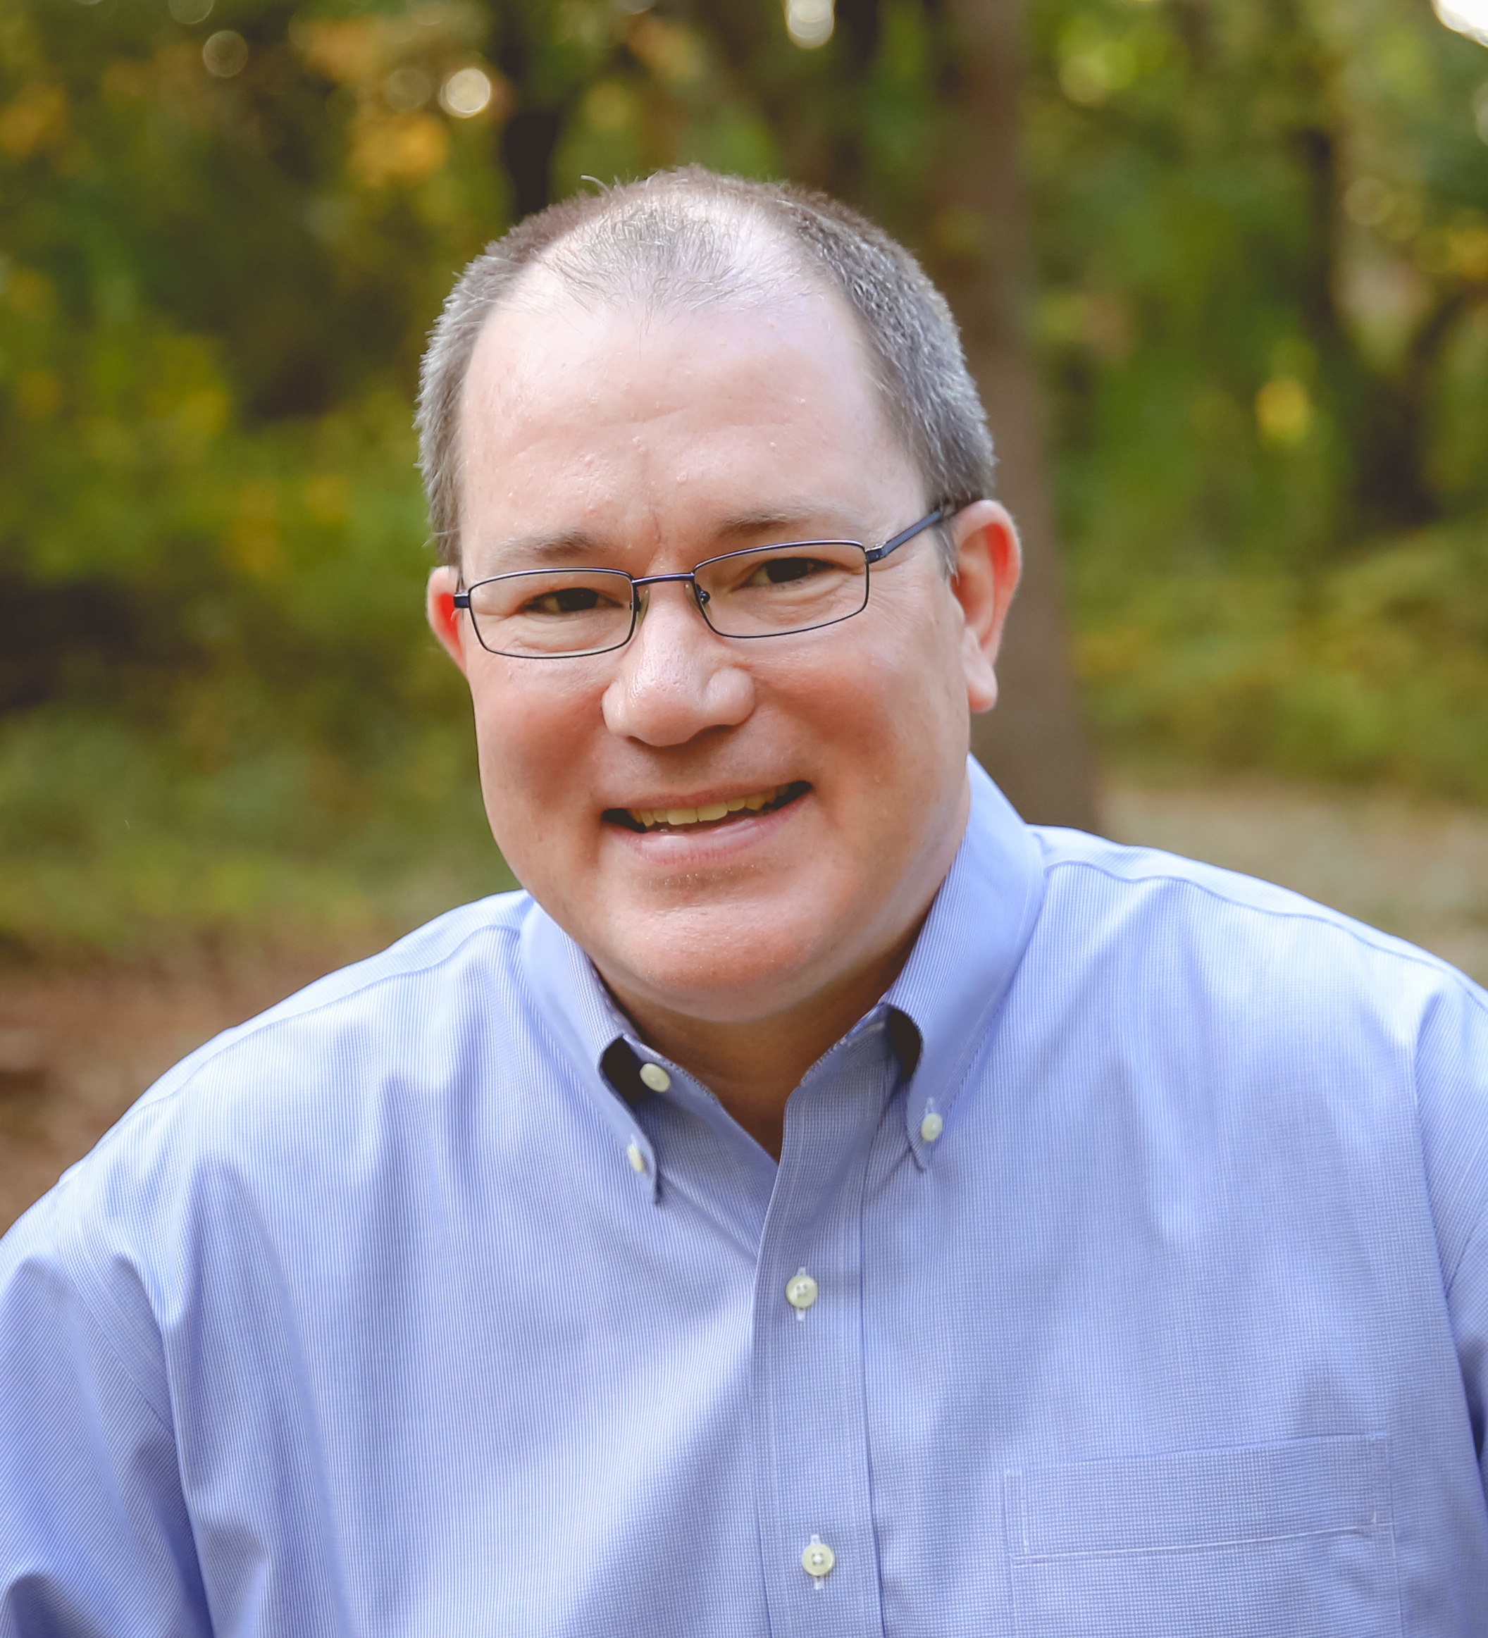
Questions?
Dr. John D. Foubert, LLC
www.johnfoubert.com

